Slide 1
Project Tortoise
Efaz Hossain
Sahithi Mutyala

Slide 2
AGENDA
Introduction
Project Tortoise As A Whole
Last Semester Progress
Current Progress
Questions?

Slide 3
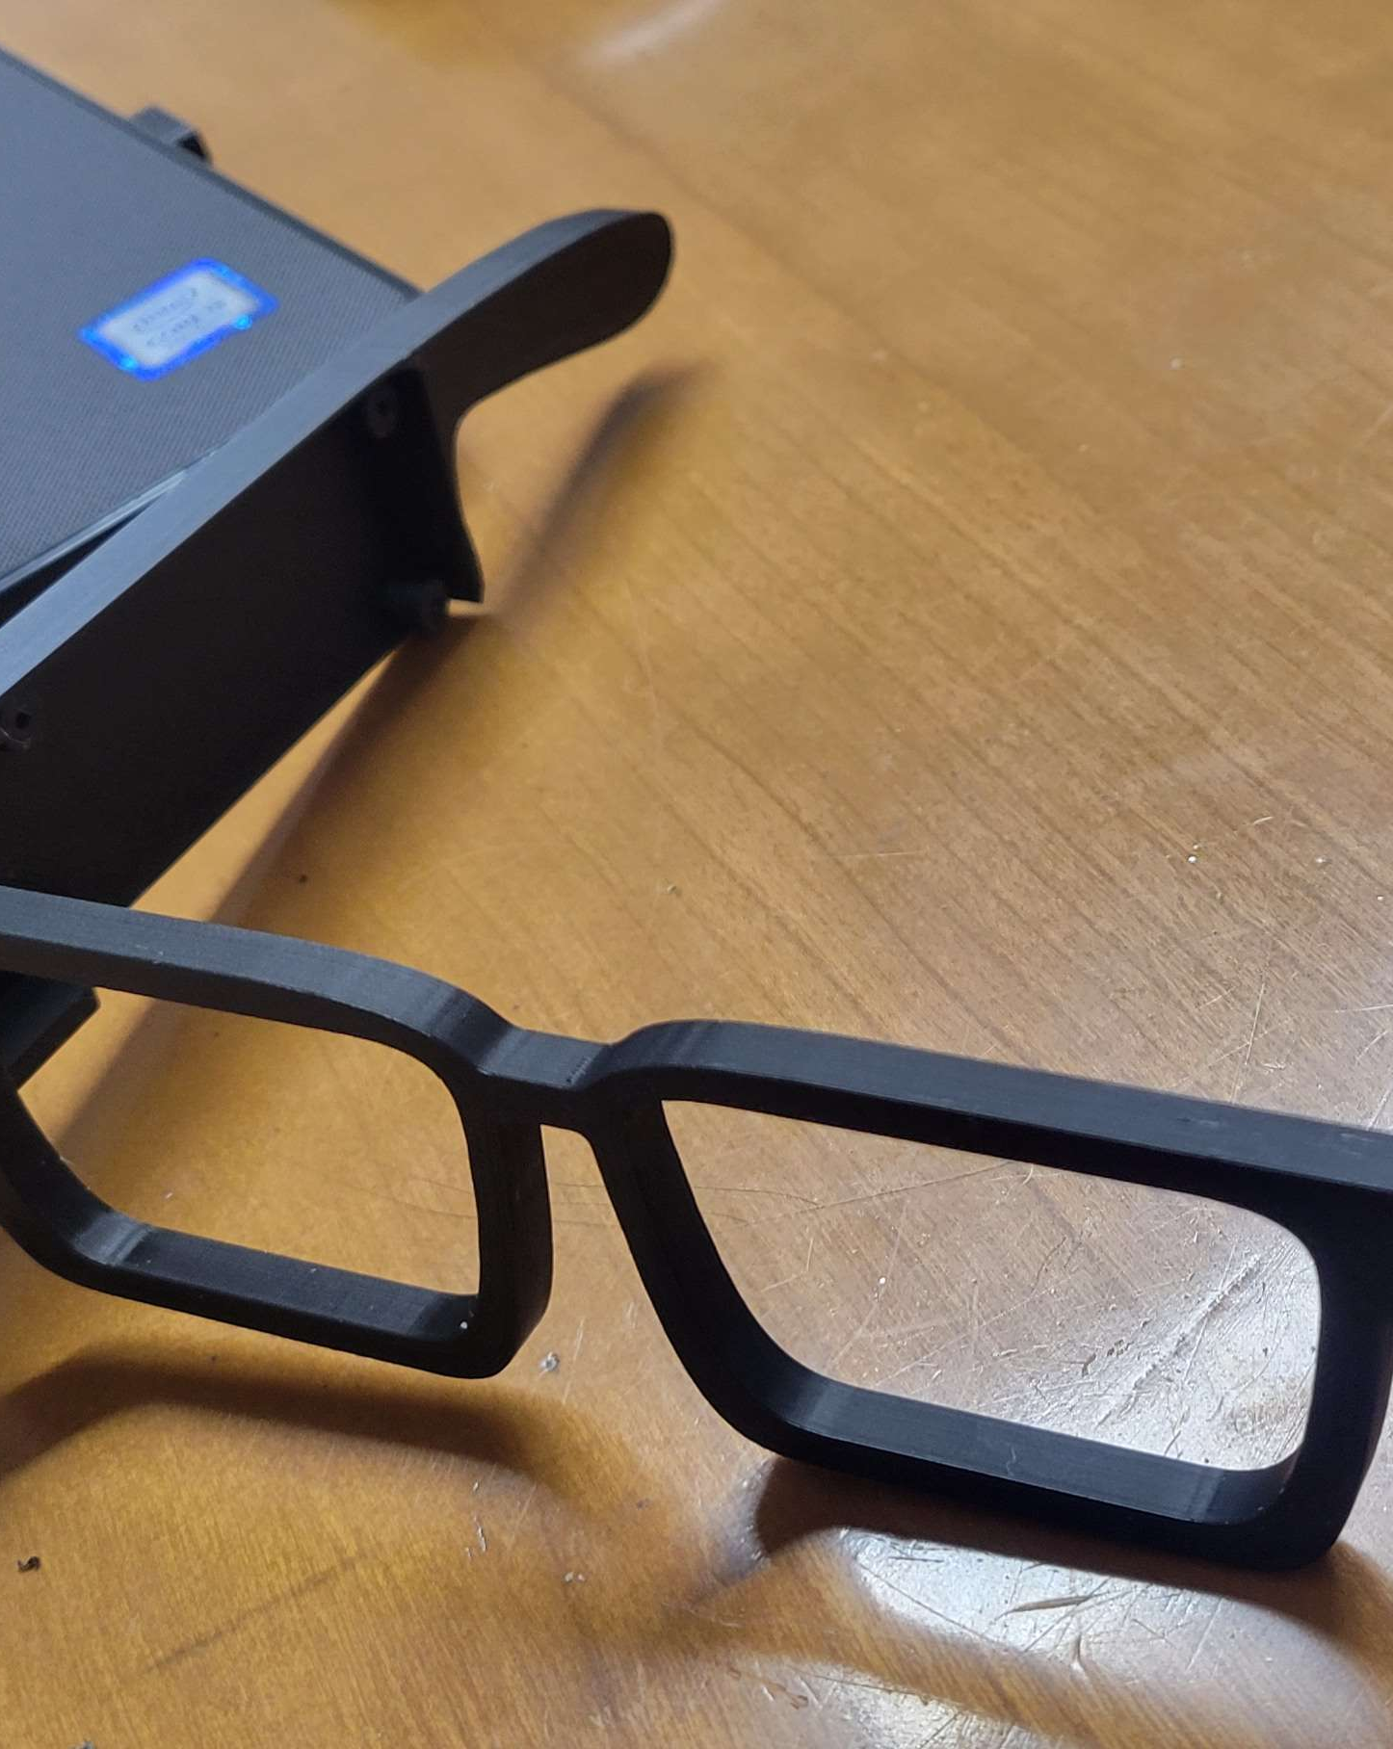
Introduction
The goal of this project is to create a robust and efficient system that can:
Detect and recognize human faces (already done last semester)
Identify and classify objects within images. The model is built using deep learning techniques and trained on various datasets to achieve high accuracy in both tasks.

Slide 4
Project Tortoise: What Is it Exactly?
Memory Assistance
Data Storage
Key Features
Facial and Object Recognition
Wandering Prevention
Impact
Enhances independence and safety for those with memory loss conditions
Restores confidence in daily interactions
What Do We Want To Do?
Create an assistive device that can delay full-time care and enhance daily task management along with easy to use functionality
Collect and store data of patient/caretakers
A bit of a privacy issue but we’re taking considerations into how to lessen this as a whole
Use stored image data to build a database for our models to pull through when using for recognition and tracking of objects
Thinking of using AirTags as a base for this

Slide 5
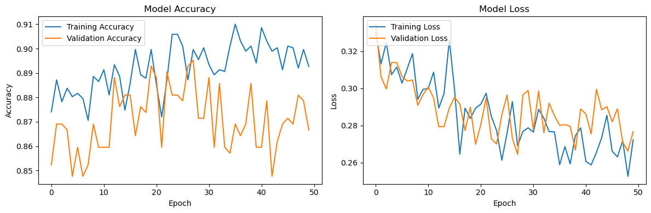
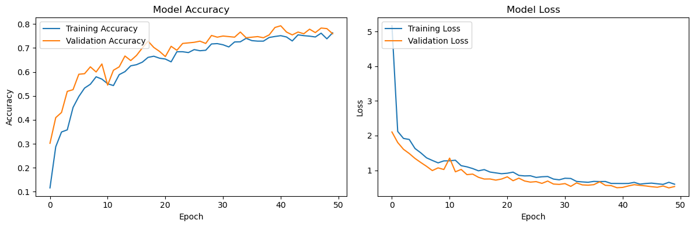
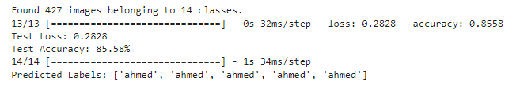
Last Semester Progress
Worked on Facial Detection Model
Averages out at around 83-86% accuracy from trained faces
Averages at around 85% accuracy from new data
API detects labels correctly
App was being worked on

Slide 6
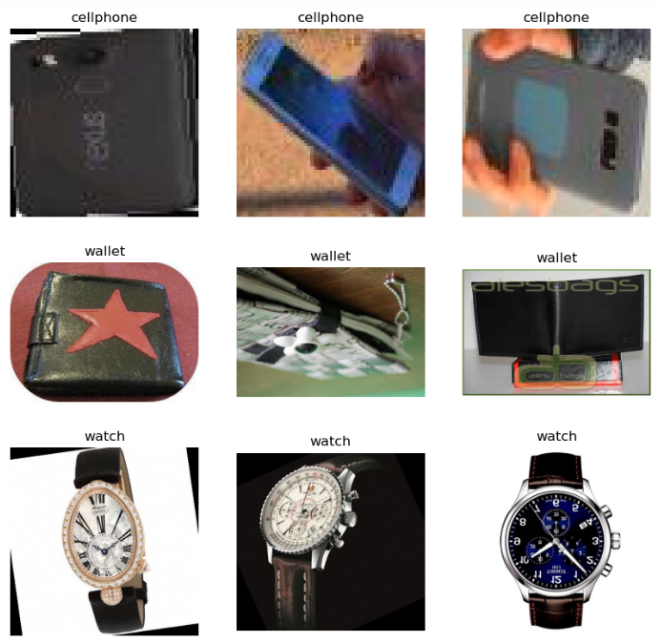

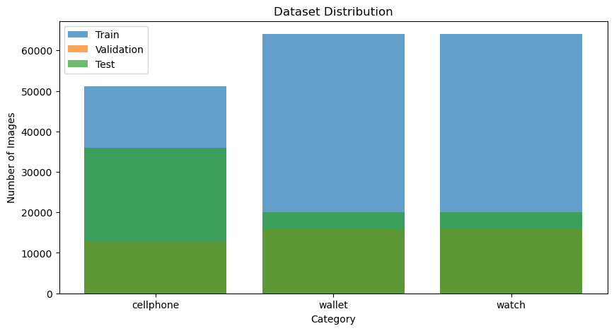
Current Progress
Started basic EDA on object dataset
Viewing each class
Checked how many images are in each
Split dataset into train/val/test (65/20/15)
Started automatic labeling and boundary box formation
Plans to start using YOLO11

Slide 7
Thank you!
Any questions?

